Slide 1
LISTENING SKILL
TOEFEL

Slide 2
CONTENTS LISTENING SKILL
1.Gist-Purpose and Gist-Content 2.Detail 3.Function 4.Attitude 5.Organization 6.Connecting Content 7.Making Inferences

Slide 3
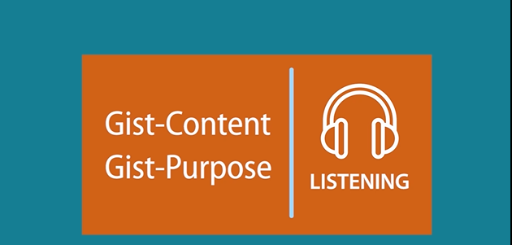
GIST PURPOSE & GIST CONTENTS
QUESTION

Slide 4
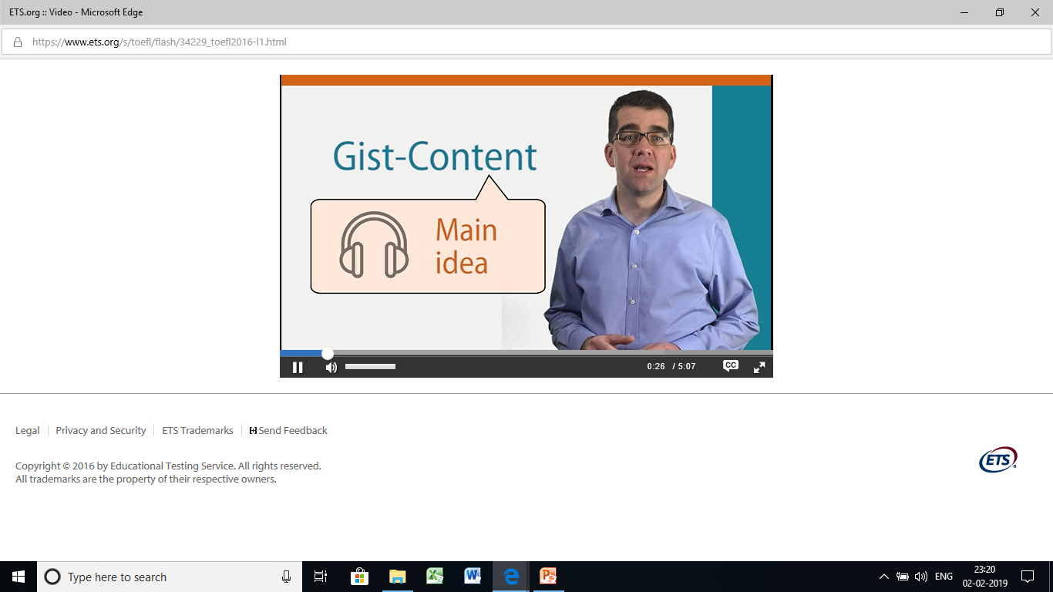
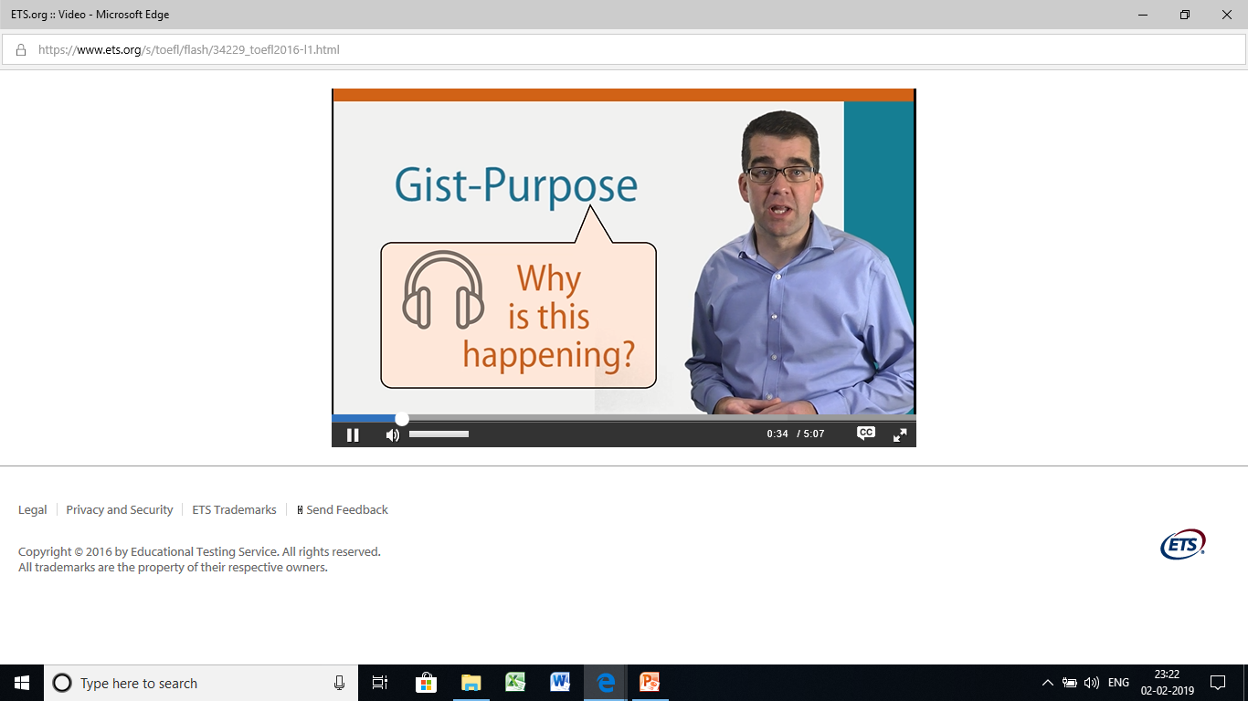
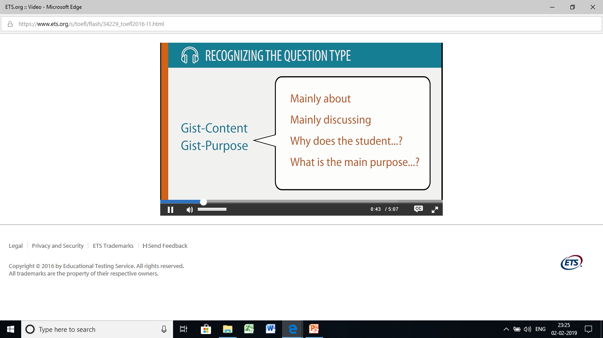
Notes:
GIST content questions ask you to clarify the main idea,gist purpose question ask to identify the purpose.

Slide 5
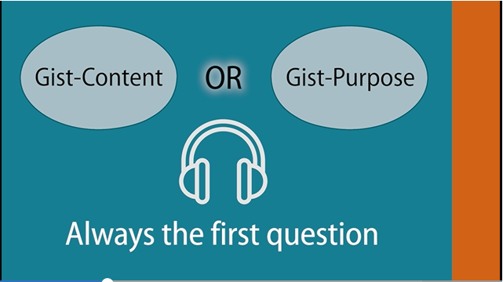
Notes:
In listening content,there will always be a gist content question or a gist purpose question but not both

Slide 6
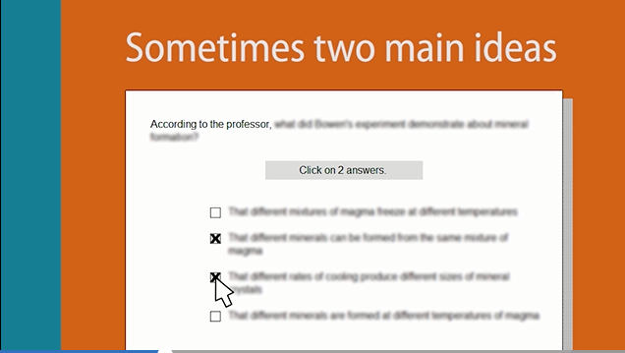

Slide 7
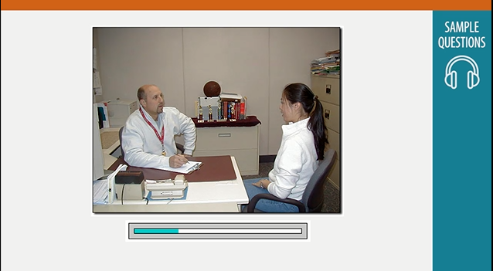
Notes:
Audio clip -ALE COACH: Hi, Elizabeth. FEMALE STUDENT: Hey, Coach. I just thought I’d stop by to see what I missed while I was gone. MALE COACH: Well, we’ve been working real hard on our plan for the next game . . . I’ve asked Susan to go over it with you before practice this afternoon, so you’ll know what we’re doing. FEMALE STUDENT: Okay. MALE COACH: By the way, how did your brother’s wedding go? FEMALE STUDENT: Oh, it was beautiful. And the whole family was there. I saw aunts and uncles and cousins I hadn’t seen in years. MALE COACH: So it was worth the trip. FEMALE STUDENT: Oh definitely. I’m sorry I had to miss practice, though. I feel bad about that. MALE COACH: Family’s very important. FEMALE STUDENT: Yep. Okay, I guess I’ll see you this afternoon at practice, then. MALE COACH: Just a minute. There are a couple of other things I need to tell you. FEMALE STUDENT: Oh, okay. MALE COACH: Uh . . . First, everybody’s getting a new team jacket. FEMALE STUDENT: Wow. How did that happen? MALE COACH: A woman who played here about 20, 25 years ago came through town a few weeks ago and saw a game, and said she wanted to do something for the team, so . . . FEMALE STUDENT: So she’s buying us new jackets? MALE COACH: Yep. FEMALE STUDENT: Wow, that’s really nice of her.
MALE COACH: Yes, it is. It’s great that former players still care so much about our school and our basketball program . . . Anyway you need to fill out an order form. I’ll give it to you now, and you can bring it back this afternoon. I’ve got the forms from the other players, so as soon as I get yours we can order. Maybe we’ll have the jackets by the next game.
FEMALE STUDENT: OK.
MALE COACH: Great. And the next thing is, you know Mary’s transferring to another college next week, so we’ll need someone to take over her role as captain for the second half of the season. And the other players unanimously picked you to take over as captain when Mary leaves.
FEMALE STUDENT: Wow. I saw everybody this morning, and nobody said a word.
MALE COACH: They wanted me to tell you. So, do you accept?
FEMALE STUDENT: Of course!

Slide 8
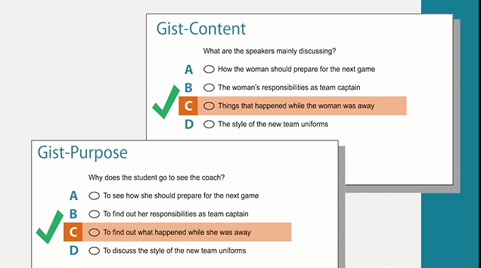
Notes:
FEMALE STUDENT: I just thought I’d stop by to see what I missed while I was gone.

Slide 9
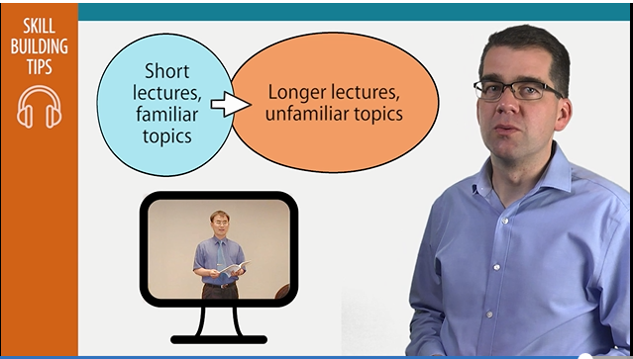
Notes:
Practice tips : First practice listening to short lectures with familiar topics and then move on to long lectures with unfamiliar topic. Listen to academic lectures in English as much as possible. Be sure to listen to lectures in various subject areas: science, social science, business, arts, literature. You can search online for universities that post their lectures for free. Start with short lectures on topics you are familiar with, then build up to longer ones on topics that are not familiar to you. Listen to the same lecture multiple times if you need to.

Slide 10
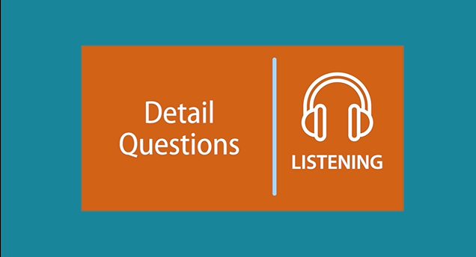
2. LISTENING – DETAIL QUESTION
Notes:
Specific question

Slide 11

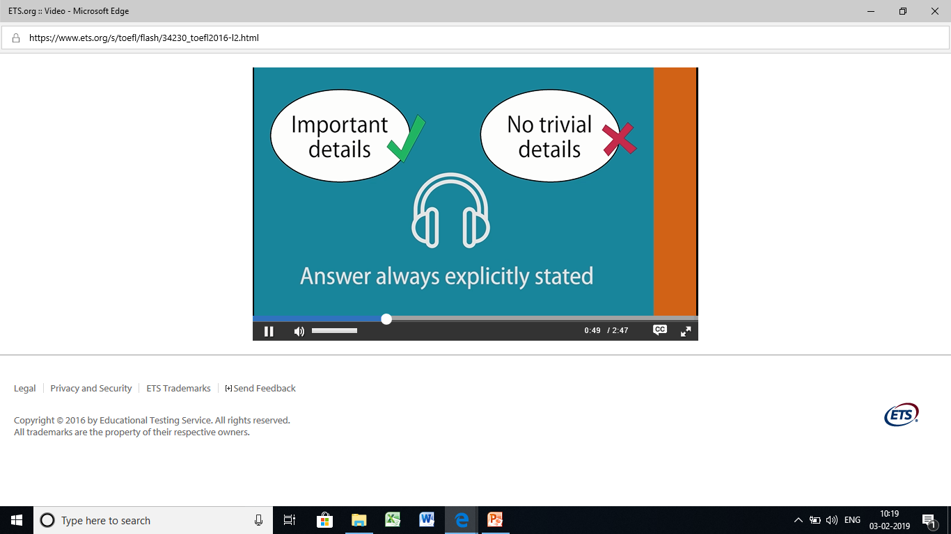
Notes:
Detail questions will always ask about an important conceptual detail. You will not be expected to memorize trivial details, such as whether something happened in 1977 or 1978. The answer to a Detail question will always be explicitly stated in the listening conversation or lecture.

Slide 12
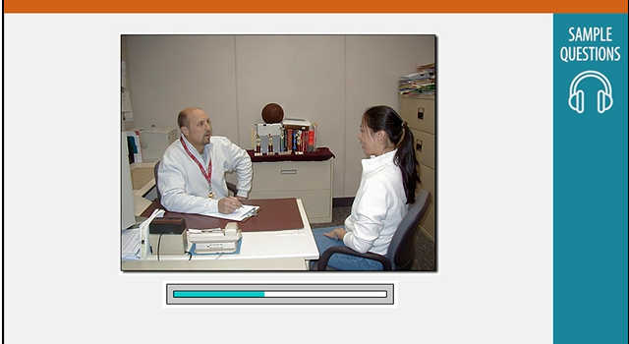
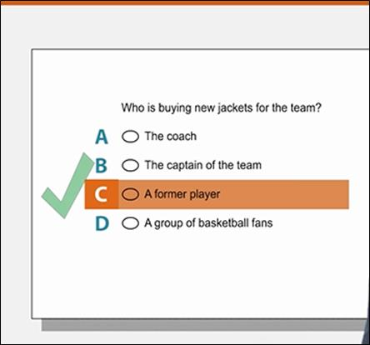
Notes:
FEMALE STUDENT: Okay, I guess I'll see you this afternoon at practice, then. MALE COACH: Just a minute. There are a couple of other things I need to tell you. FEMALE STUDENT: Oh, okay. MALE COACH: Uh . . . First, everybody's getting a new team jacket. FEMALE STUDENT: Wow. How did that happen? MALE COACH: A woman who played here about 20, 25 years ago came through town a few weeks ago and saw a game, and said she wanted to do something for the team, so . . . FEMALE STUDENT: So she's buying us new jackets? MALE COACH: Yep.

Slide 13
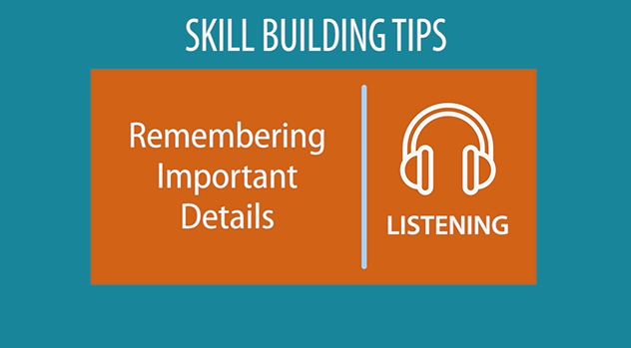
``

Slide 14

3.LISTENING – FUNCTION QUESTION QUESTIONS

Slide 15
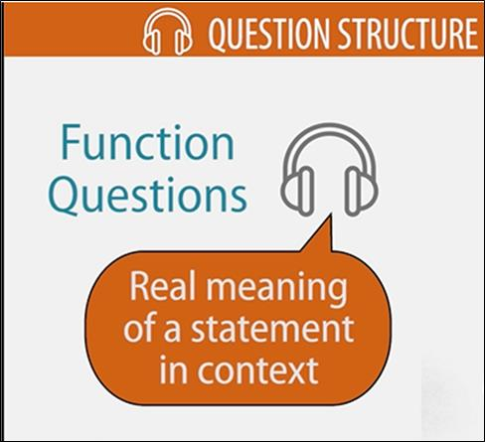
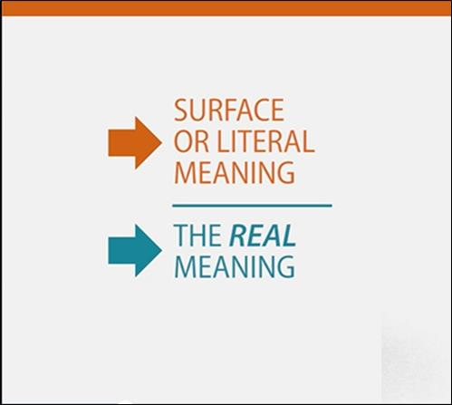
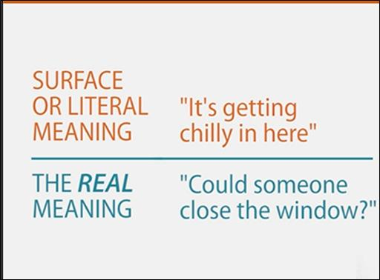

Slide 16


Slide 17
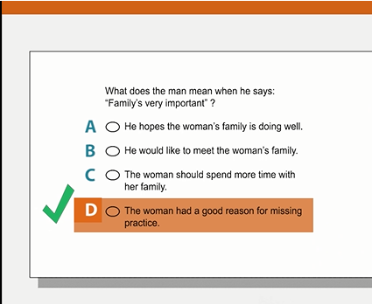
Notes:
MALE COACH: Hi, Elizabeth. FEMALE STUDENT: Hey, Coach. I just thought I'd stop by to see what I missed while I was gone. MALE COACH: Well, we've been working real hard on our plan for the next game . . . I've asked Susan to go over it with you before practice this afternoon, so you'll know what we're doing. FEMALE STUDENT: Okay. MALE COACH: By the way, how did your brother's wedding go? FEMALE STUDENT: Oh, it was beautiful. And the whole family was there. I saw aunts and uncles and cousins I hadn't seen in years. MALE COACH: So it was worth the trip. FEMALE STUDENT: Oh definitely. I'm sorry I had to miss practice, though. I feel bad about that. MALE COACH: Family's very important. FEMALE STUDENT: Yep. Okay, I guess I'll see you this afternoon at practice, then.
So when the coach asks about the wedding, and says things like, "so it was worth the trip" and "family is very important," you can conclude that the coach understands and agrees with her decision to miss practice. So D is the correct answer.

Slide 18
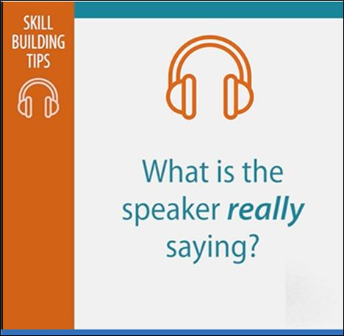
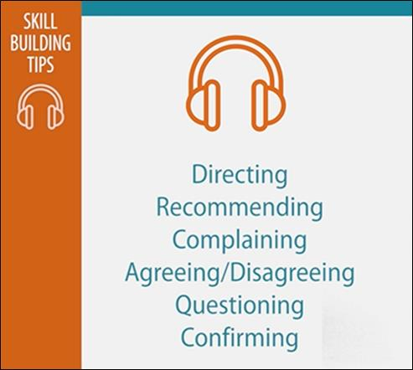

Slide 19
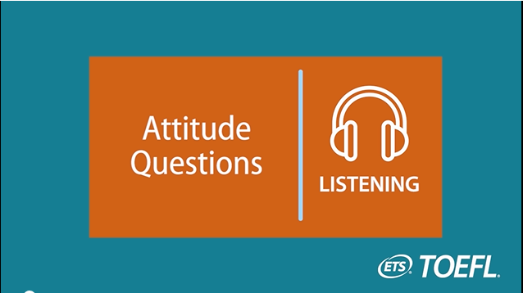
4. ATTITUDE - QUESTION

Slide 20
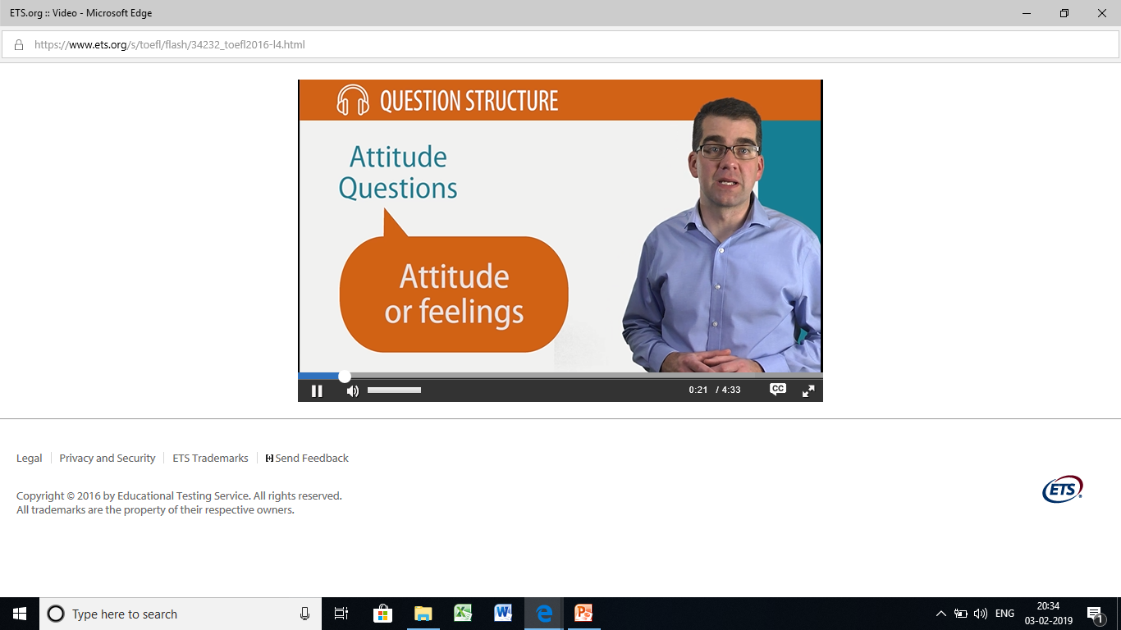
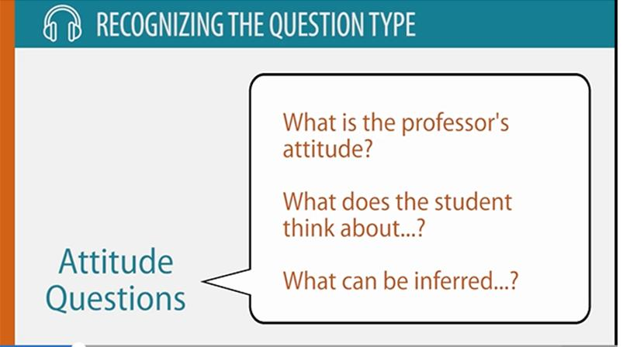

Slide 21


Slide 22
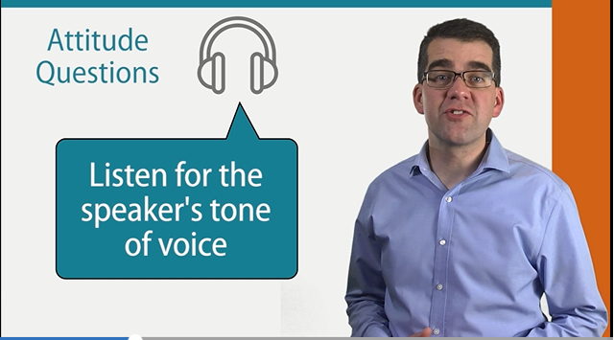

Slide 23
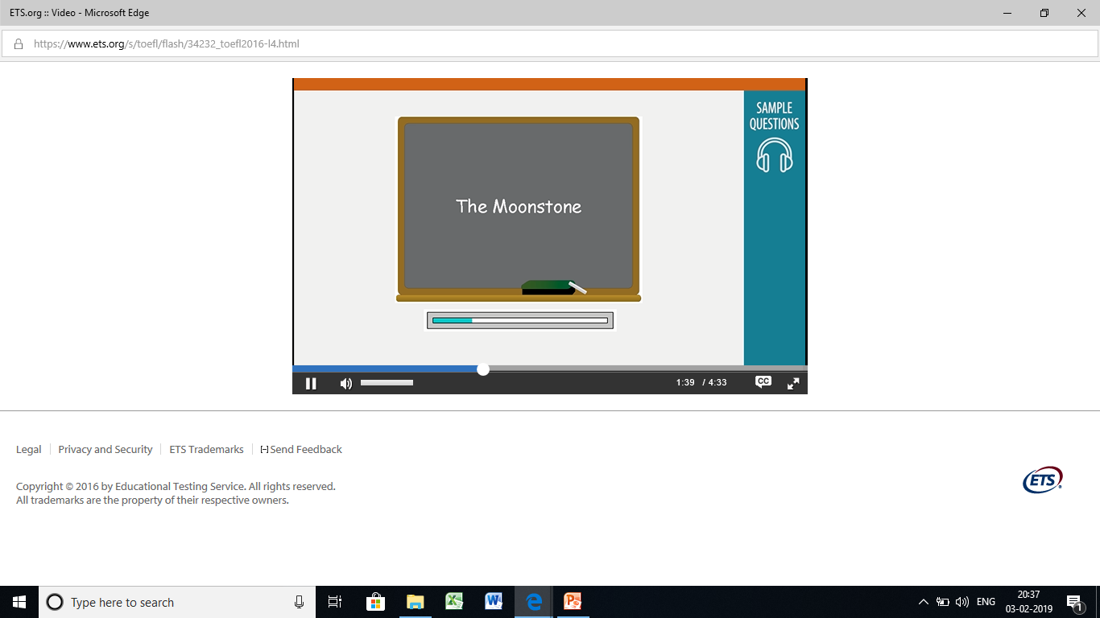
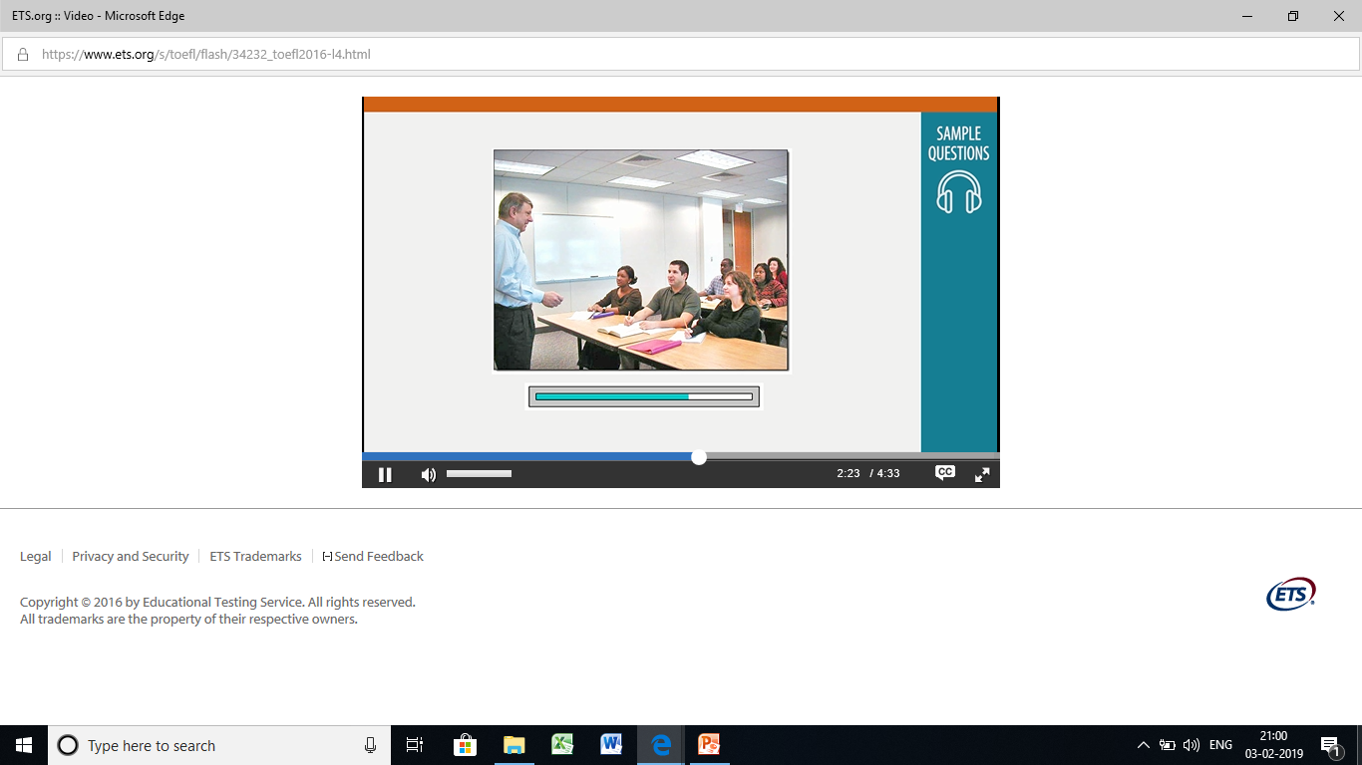
Notes:
In his speech, the speaker mentions that this is the first full length detective novel ever written.I recommend even as a fun book to read,if you have not read. Today I'd like to introduce you to a novel that um some critics consider the finest detective novel ever written. Um, it was also the first. We're talking about The Moonstone by Wilkie Collins. Now, um, there are other detective stories that preceded The Moonstone historically—Um, notably uh the work of Poe . . . um, Edgar Allen Poe's stories, such as "The Murders in the Rue Morgue" and . . . um, "The Purloined Letter." Now these were short stories that featured a detective . . . uh, probably the first to do that. But The Moonstone, which follows them by about twenty years—it was published in 1868—uh, this is the first full-length detective novel ever written. Now, in The Moonstone—if you read it as . . . uh, come to it as uh, a contemporary reader— what's interesting is that most of the features you find in almost any detective novel are in fact already present. Um, it's hard at this juncture to read this novel and realize that no one had ever done that before, because it all seems so strikingly familiar. It's, it's really a wonderful novel and I recommend it, even just as a fun book to read, if you've never read it.

Slide 24
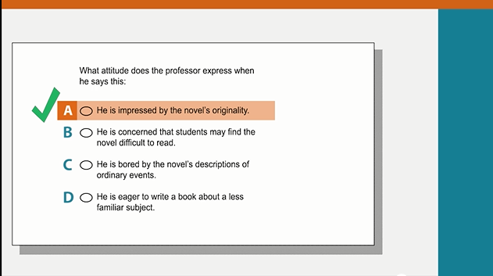
Notes:
PROFESSOR: Um, it's hard at this juncture to read this novel and realize that no one had ever done that before, because it all seems so strikingly familiar.

Slide 25
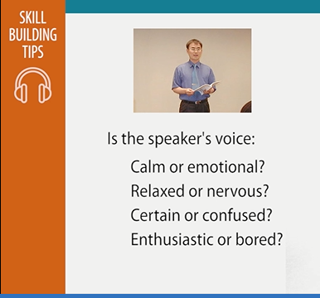
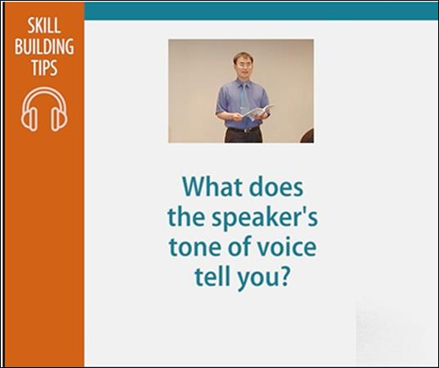

Slide 26
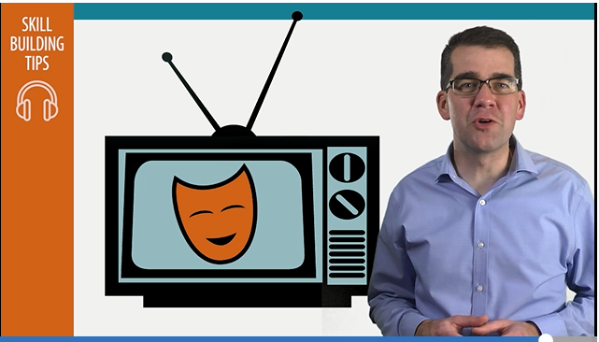
Notes:
Watching comedy show is a good way to practice attitude question

Slide 27
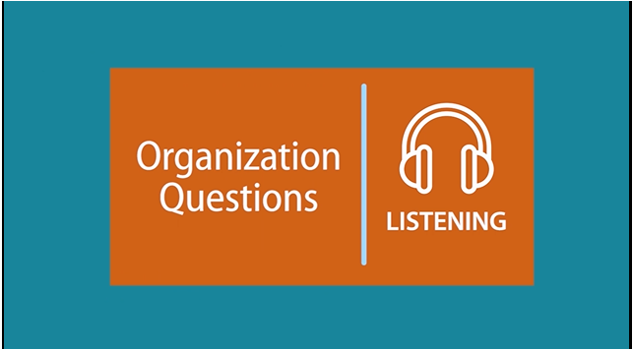
5. Organization Questions

Slide 28
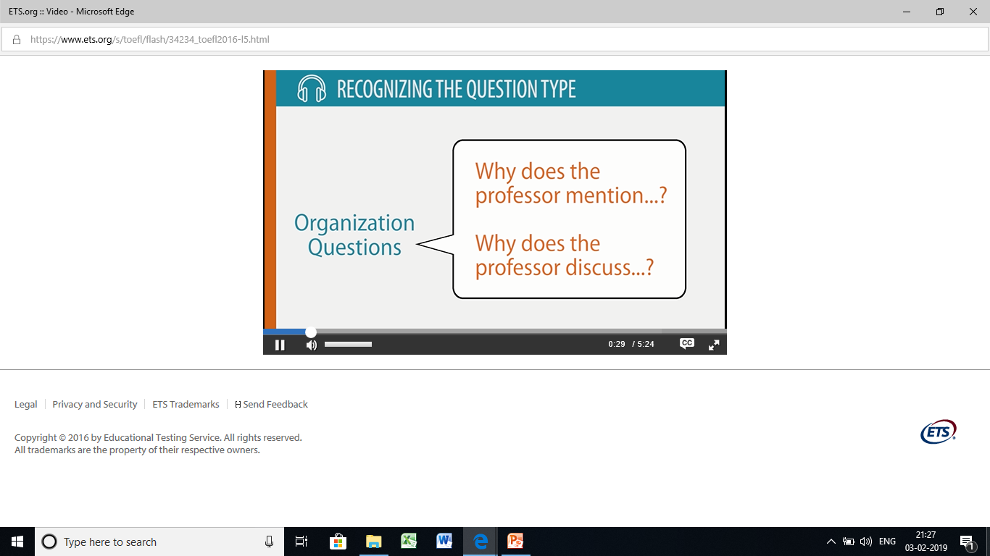
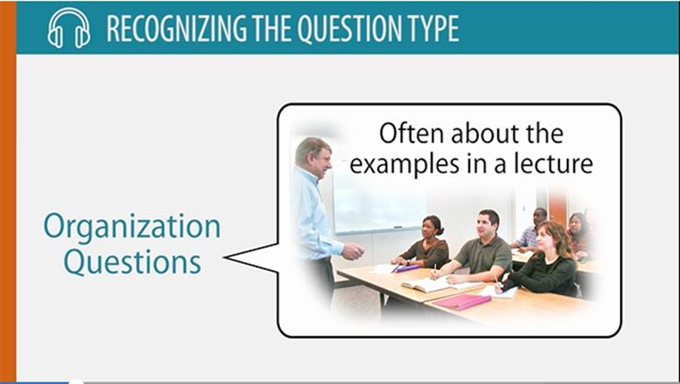

Slide 29
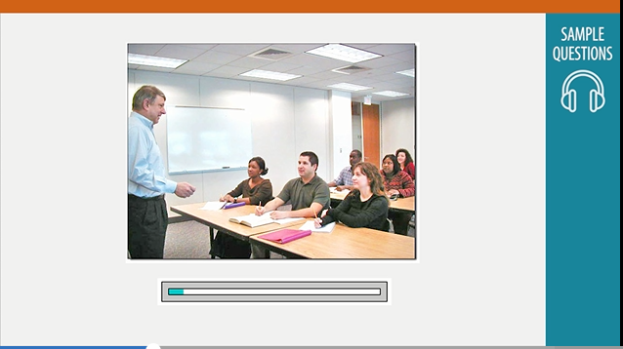
This is a lecture by a professor on the detective novel “The Moonstone “
Notes:
So, now Cuff arrives. Uh, Cuff is the man who's coming to solve the mystery, and-and again he has a lot of the characteristics that future detectives throughout the history of this genre will have. Um, He's eccentric. Um, He has a hobby that he's obsessive about—in this . . . uh, in this case, it's the love of roses. He's a fanatic about the breeding of roses; and here think of Nero Wolfe and his orchids, uh Sherlock Holmes and his violin, uh a lot of those later classic detective heroes have this kind of outside interest that they uh . . . they go to as a kind of antidote to the evil and misery they encounter in their daily lives. Now, um, these detective heroes . .um. . they have this characteristic of being smart, incredibly smart, but of not appearing to be smart. And uh most importantly, from uh a kind of existential point of view, these detectives see things that other people do not see. And that's why the detective is such an important figure, I think, in our modern imagination. Um, In the case of The Moonstone—um I don't want to say too much here and spoil it for you—but the clue that's key to . . . the solving of the crime is a smeared bit of paint in a doorway. Um, of course, the regular police have missed this paint smear or made some sort of unwarranted assumption about it. Cuff sees this smear of paint—um this paint, the place where the paint is smeared—and realizes that from this one smear of paint you can actually deduce the whole situation . . .um, the whole world. And-And that's what the hero in a detective novel like this . . . brings to it that the other characters don't—it's um it's this ability to see meaning where others see no meaning and to bring order . . . to where uh it seems there is no order.

Slide 30
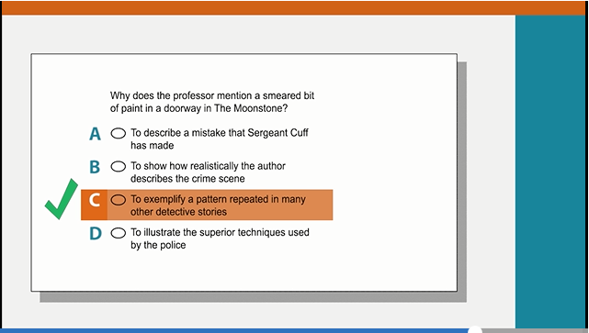
Notes:
Choice A can be ruled out because the professor directly states that noticing the smeared paint is the key to solving the crime, not a mistake.
On-screen: [red x next to answer option A] Michael: For option B to be correct, there would have been a pattern of discussing details from the crime scene. But the smeared paint is the only visual detail from the crime scene that is mentioned. So option B is not correct.
On-screen: [red x next to answer option B]
Michael: Option D can be eliminated because the professor states that the police officers didn't notice the smeared paint.
On-screen: [red x next to answer option D]
Michael: Option C is the best answer because the professor talks about hero detectives in mystery novels and the characteristics they have in common. The professor indicates that there is a pattern when he says this:
PROFESSOR: These detectives see things that other people do not see.
On-screen: [Green check mark next to answer option D]

Slide 31
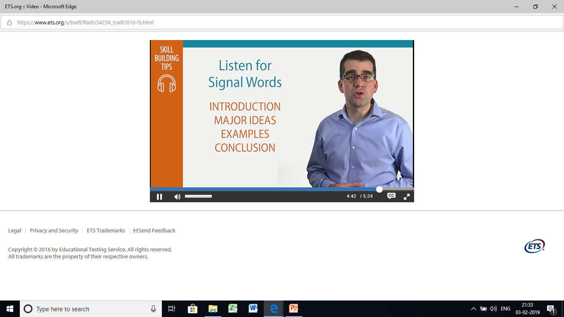
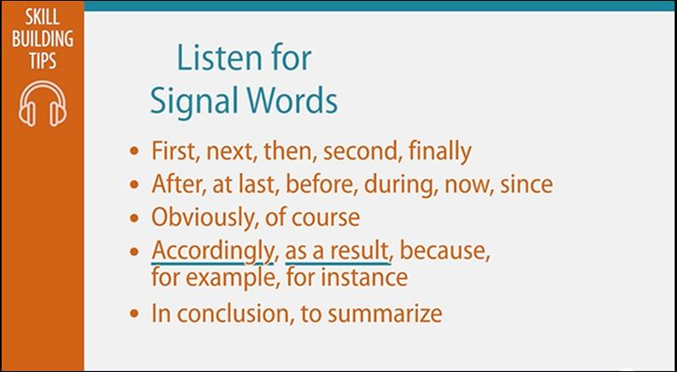
Notes:
Listen for Signal Words ,Introduction,Major ideas.Examples,Conclusion.First, next, then, second, finally;After, at last, before, during, now, since
Obviously, of course;Accordingly, as a result, because, for example, for instance;In conclusion, to summarize.

Slide 32

6. Connecting Content Questions

Slide 33
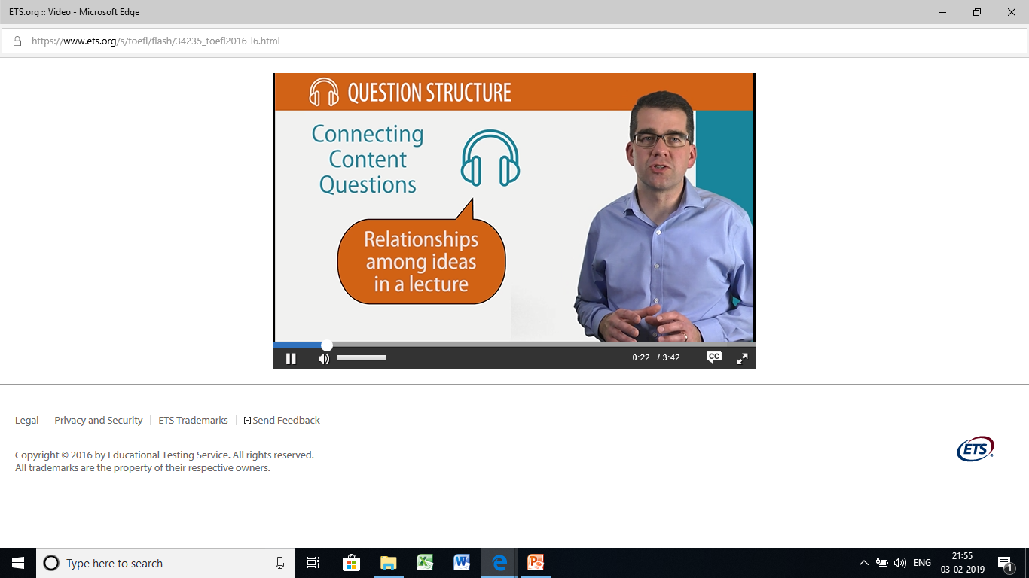
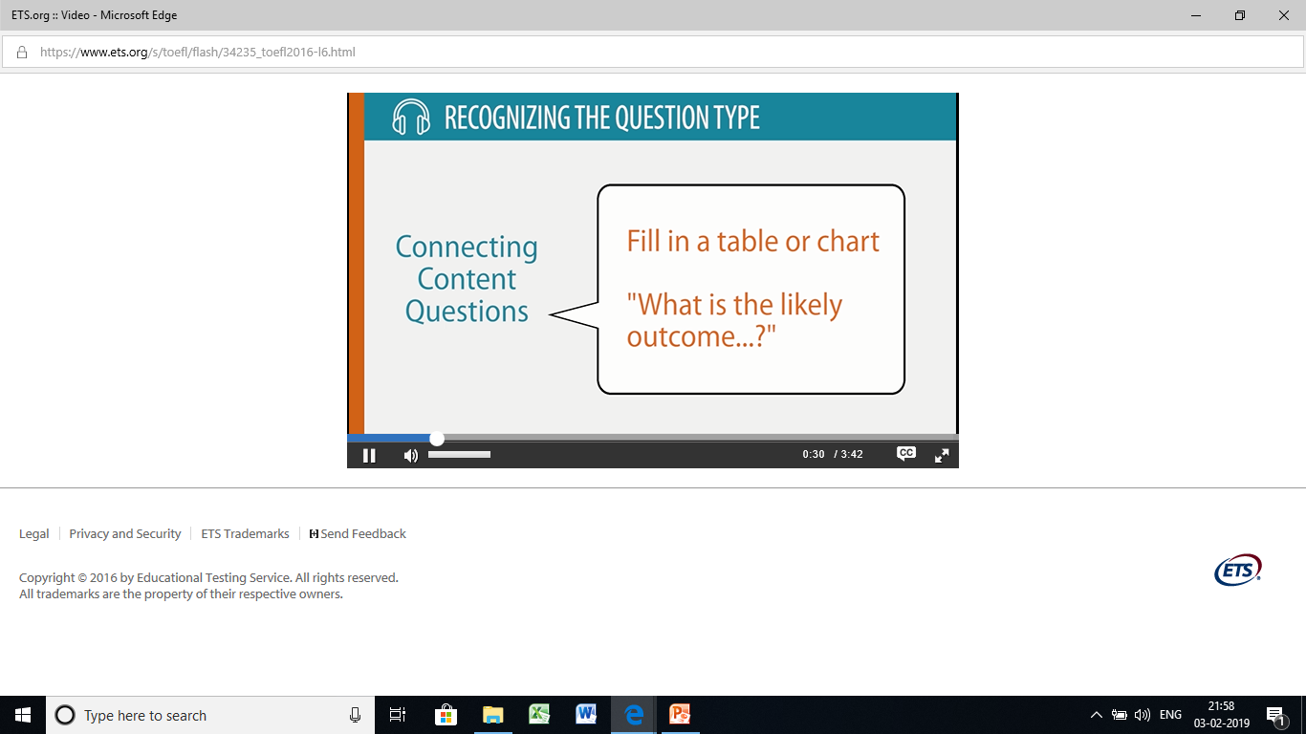

Slide 34
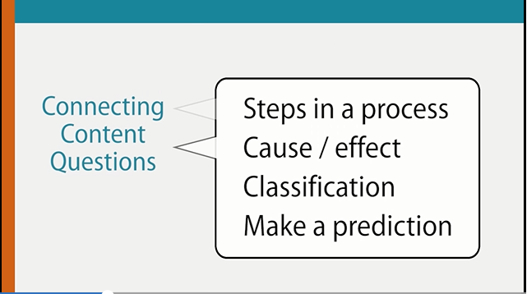

Slide 35
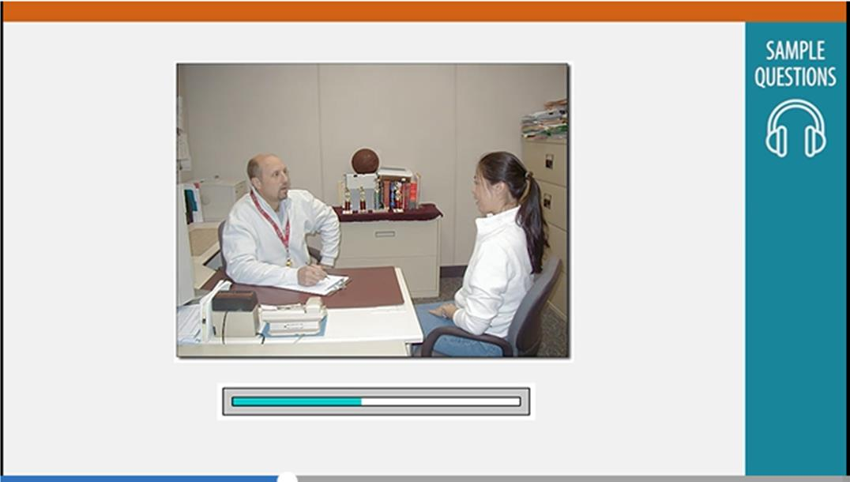
Notes:
MALE COACH: And the next thing is, you know Mary's transferring to another college next week, so we'll need someone to take over her role as captain for the second half of the season. And the other players unanimously picked you to take over as captain when Mary leaves.
FEMALE STUDENT: Wow. I saw everybody this morning, and nobody said a word.
MALE COACH: They wanted me to tell you. So, do you accept?
FEMALE STUDENT: Of course! But Susan's a much better player than I am. I'm really surprised they didn't pick her.
MALE COACH: They think you're the right one. You'll have to ask them their thoughts.
FEMALE STUDENT: Okay . . . I guess one of the first things I'll have to do as captain is make sure we get a thank-you card out to the lady who's buying us the jackets.
MALE COACH: Good idea. I have her address here somewhere.
FEMALE STUDENT: And I'll make sure the whole team signs it.
MALE COACH: Good. That's all the news there is. I think that's it for now. Oh, let me get you that order form.

Slide 36
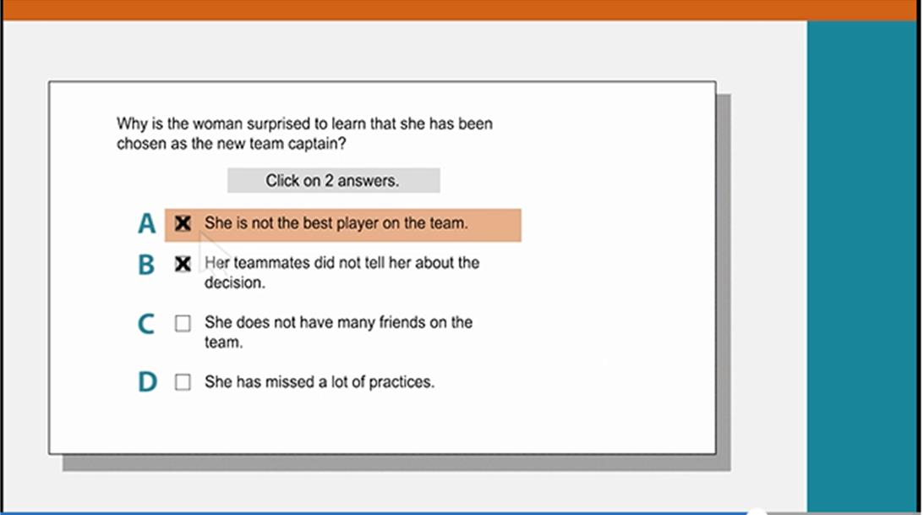
Notes:
MALE COACH: And the other players unanimously picked you to take over as captain when Mary leaves. FEMALE STUDENT: Wow. I saw everybody this morning, and nobody said a word.
MICHAEL: It's clear that "everyone" refers to the other team members and "no one said a word" means that no one on the team said anything about having picked her to be their new captain. So B is one answer.
On-screen: Why is the woman surprised to learn that she has been chosen as the new team captain? Click on 2 answers.
She is not the best player on the team.
Her teammates did not tell her about the decision.
She does not have many friends on the team.
She has missed a lot of practices.
The second answer is explained when the student says this:
FEMALE STUDENT: But Susan's a much better player than I am. I'm really surprised they didn't pick her.
MICHAEL: By saying someone else on the team is a better player that means that she is not the best player. So A is the other correct answer.
On-screen: Why is the woman surprised to learn that she has been chosen as the new team captain? Click on 2 answers.
She is not the best player on the team.
Her teammates did not tell her about the decision.
She does not have many friends on the team.
She has missed a lot of practices.

Slide 37
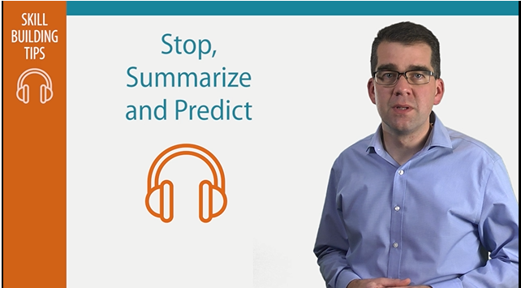

Slide 38

7. Inference Questions

Slide 39
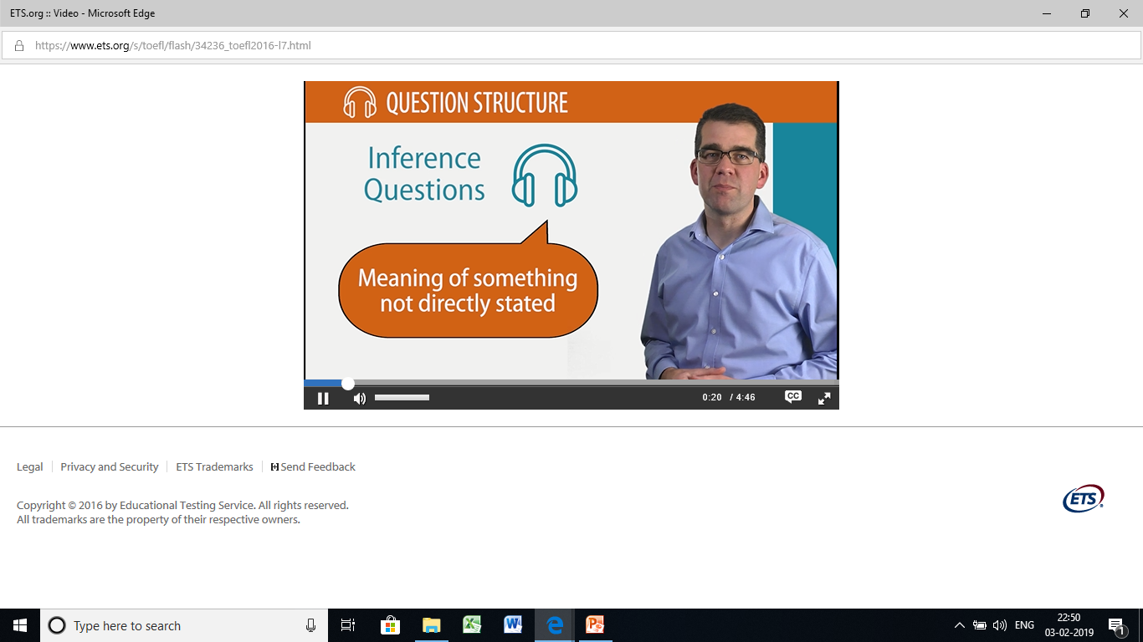
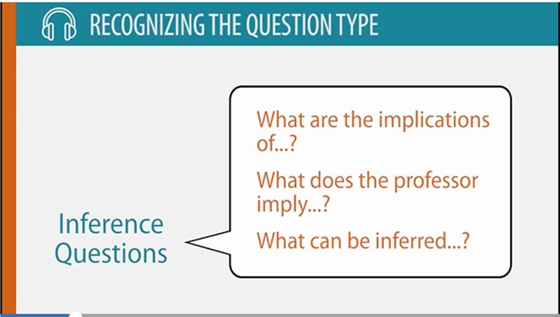

Slide 40

Notes:
PROFESSOR: Um, so in The Moonstone, as I said, uh, Collins did much to establish the conventions of the detective genre. Uh, I'm not gonna go into the plot at length, but, you know, the basic setup is . . . um, there's this diamond of great uh . . of great value, uh, a country house, uh, the diamond mysteriously disappears in the middle of the night, um, the local police are brought in, in an attempt to solve the crime, and they mess it up completely, uh, and then the true hero of the book arrives. That's Sergeant Cuff. Now, Cuff, this extraordinarily important character um . . . well, let me try to give you a sense of who Sergeant Cuff is, by first describing the regular police. And uh this is the dynamic that you're going to see throughout the history of the detective novel, um, where you have the regular cops—who are well-meaning, but officious and bumblingly inept—and uh they are countered by a figure who's eccentric, analytical, brilliant, and . . . and able to solve the crime. So, uh first the regular police get called in to solve the mystery—Um, in this case, detective, uh, Superintendent Seegrave. When Superintendent Seegrave comes in, uh he orders his minions around, uh they bumble, and they actually make a mess of the investigation, uh which you'll see repeated—um, you'll see this pattern repeated, particularly in the Sherlock Holmes stories of a few years later where, uh, Inspector Lestrade, this well-meaning idiot, is always countered, uh, by Sherlock Holmes, who's a genius.

Slide 41

Notes:
NARRATOR: What does the professor imply when he says this: PROFESSOR: Well, let me try to give you a sense of who Sergeant Cuff is, by first describing the regular police.
We can see that this is an inference question because it uses the word "imply" and asks the listener to understand the meaning of something that is not directly stated by the professor.

Slide 42
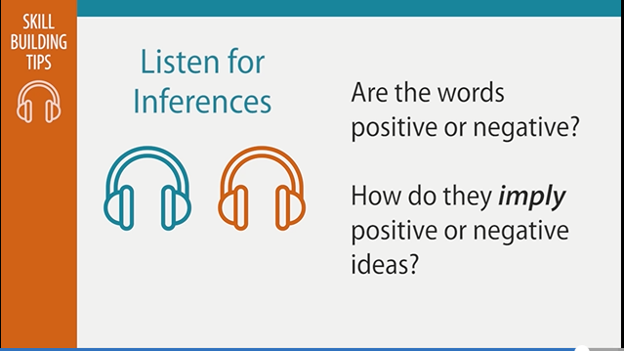
Notes:
Michael: Here's a tip for improving your listening skills: Listen to recordings of two speakers with different viewpoints about the same topic. What words do the speakers use to support their ideas? Are the words mainly positive or negative? Then look at how they imply positive or negative ideas without saying them directly.
On-screen: Skill Building Tip – Listen for Inferences
Are the words positive or negative? How do they imply positive or negative ideas?

Slide 43
E N D

